Slide 1


Sales Strategy Analysis – New Product Launch
A data-driven examination of three distinct sales methods for our new stationery line, analyzing performance metrics to optimize future campaign strategies.
by Abdulafeez Fakorede

Slide 2

Business Goals
Evaluate 3 sales methods for new stationery line
Email campaigns
Phone calls
Combined email + call approach
Determine key performance indicators
Which method generated the highest revenue?
Which method demonstrates the greatest efficiency?
Develop recommendation
Provide a data-driven strategy recommendation for future sales campaigns based on comprehensive analysis

Slide 3

Data Overview
15,000
6
Customers
Weeks
Total sample size analyzed
Time period since product launch
3
Sales Methods
Distinct approaches tested
Data includes: Week since product launched, sales method, revenue, products sold, Years as Customers, website visit frequency, state orders shipped to

Slide 4

Data Cleaning Process
Standardize Method Names
Resolved inconsistent naming conventions across sales method entries to ensure accurate grouping
Address Missing Values
Imputed 1,074 missing revenue values using method-based averages to maintain dataset integrity
Validate Outliers
Retained legitimate outliers after validation (e.g., high-value purchases from long-tenure customers)

Slide 5
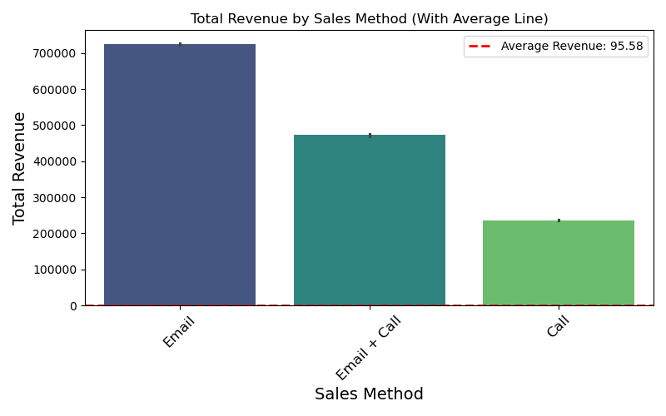
Total Revenue by Sales Method
Key Insight: Email brought in the highest total revenue, with Email + Call following closely behind, and then Call.
Key Insight: Email brought in the highest total revenue, with Email + Call following closely behind, and then Call.

Slide 6
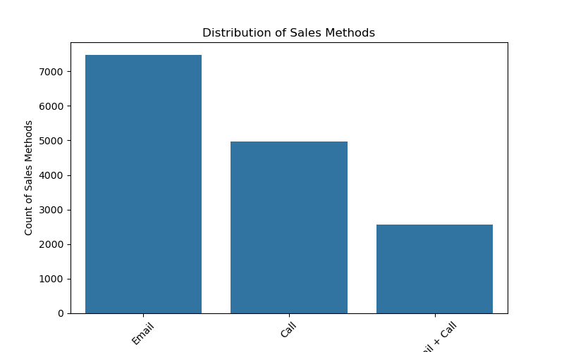
Total number of Sales per Method
Key Insight: Email dominates in the number of orders, with Call coming next, and Email + Call in the third position. Notably, Email + Call outperformed Call in revenue, underlining the high value orders in Email + Call
Key Insight: Email dominates in the number of orders, with Call coming next, and Email + Call in the third position. Notably, Email + Call outperformed Call in revenue, underlining the high value orders in Email + Call

Slide 7
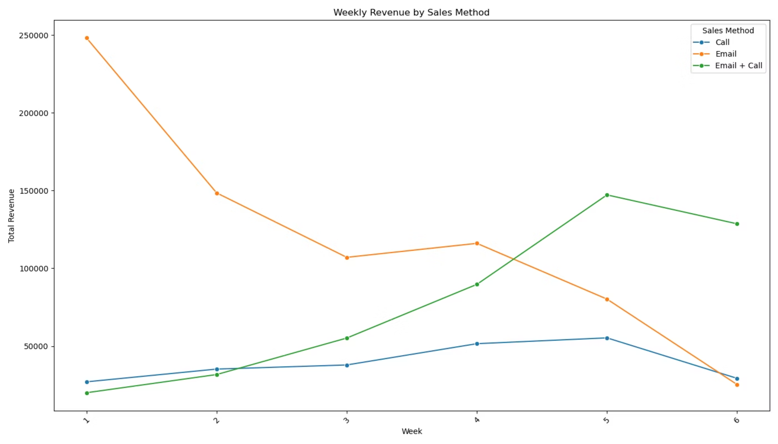
Revenue Over Time
Email shows strong initial performance but gradually declines, while Email + Call demonstrates consistent growth, overtaking Email by week 4. Call-only remains the least effective throughout the entire period.

Slide 8



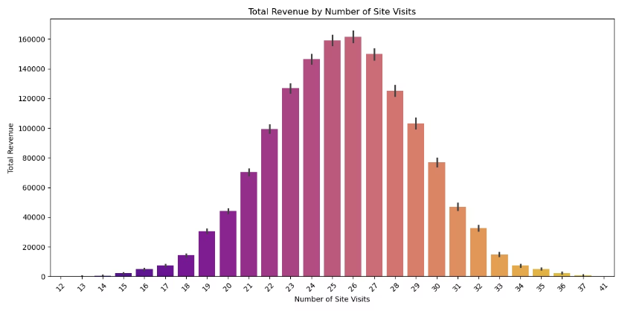
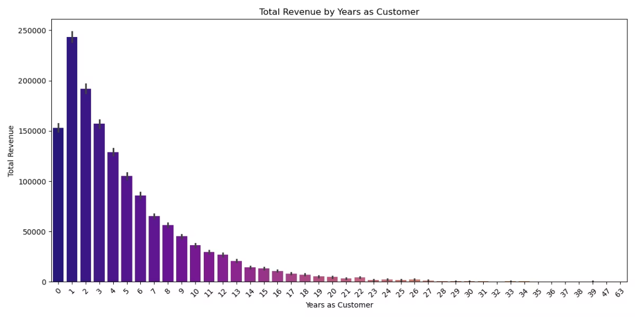
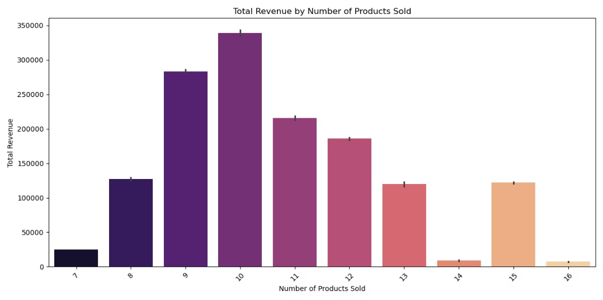
Customer Behavior Insights
Site Visit Impact
Revenue increases steadily with site visits up to 26 interactions, then shows diminishing returns with highly frequent visitors
Customer Tenure
Newer customers (0-3 years) generate significantly more revenue than long-term customers when targeted with these sales methods
Purchase Volume
The most profitable sales transactions involve approximately 10 items per order, suggesting an optimal bundle size

Slide 9


Key Metric to Monitor: ARPC
Average Revenue per Customer per Sales Method
This comprehensive metric captures both the effectiveness and efficiency of each sales approach, providing a clear indicator of overall performance.
Weekly Tracking
Monitor this metric on a weekly basis to identify trends and shifts in customer response
Dynamic Adjustment
Use performance data to guide real-time campaign optimization
Sales Method | ARPC by Sales Method
Call | $47.60
Email | $97.10
Email + Call | $183.70

Slide 10

Strategic Recommendations
1
Prioritize Email + Call approach
2
Maintain Email campaigns for baseline reach
This combined method delivers the best performance with moderate resource investment, generating 89% more revenue per customer than email-only
Use email-only for low-effort base campaigns when resources are limited, as it provides reasonable returns
3
Eliminate Call-only strategy
4
Target engagement sweet spot
This approach demonstrates low return despite high resource requirements, making it inefficient for future campaigns
Focus particularly on new, highly engaged customers with 23-27 site visits for maximum revenue potential

Slide 11

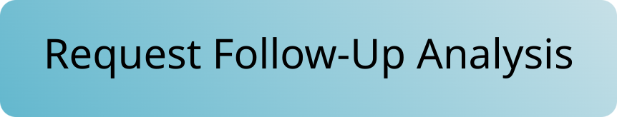

Thank You
Questions & Discussion
We welcome your insights and questions about the analysis. Your feedback will help refine our sales strategy for the new stationery line.

